Slide 1
Wildlife Health Surveillance Network in Lao PDR
Kongsy Khammavong Health Program Coordinator, WCS Lao PDR May 23, 2023

Slide 2
WCS Health Program
The first international conservation organization— recognizes the critical role of wildlife health in both conservation and development which helped pioneer the One Health movement, highlighting the links between biodiversity and global health
To address a range of threats facing wildlife, livelihoods, and human health, including zoonoses at the human-wildlife interface.
Health program in Laos has started in 2009, aims to use science-based disease research and surveillance to inform national policy and counter traditional beliefs on the health benefits of consuming wildlife.
Operationalize wildlife health surveillance
Build the technical capacity of government and local stakeholders.
Influence and contributed into developing of national policy for wildlife health surveillance.
Data Collection & Management
Notes:
A non-profit, tax-exempt, private organization established in 1895.
To saves wildlife and wild places by understanding critical issues, crafting science-based solutions, and taking conservation actions that benefit nature and humanity.
Presence in more than 60 nations, and experience helping to establish or expand over 245 protected areas across the globe.

Slide 3
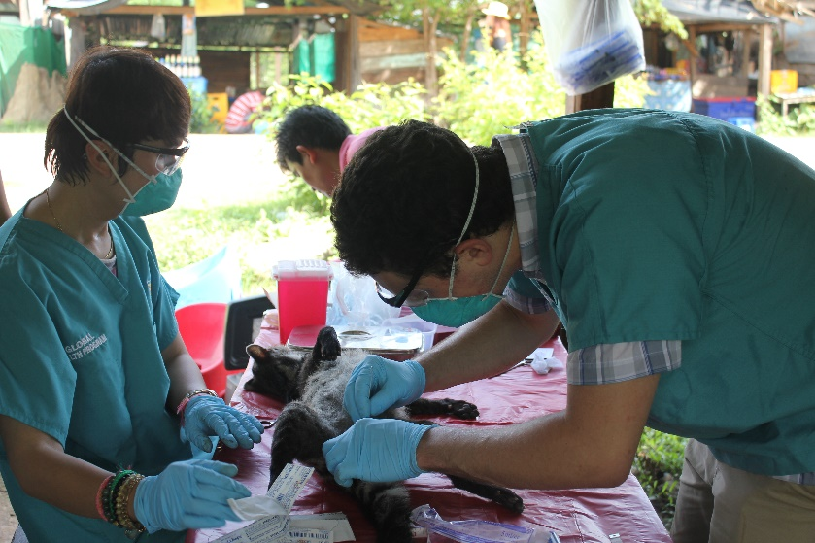
WCS Health Program in Lao PDR
Operationalize wildlife health surveillance:
Passive surveillance: Responded to wildlife dead/sick event detections in two national protected areas.
Active surveillance: Collected samples from wild animals where interface of human-domestic-wildlife includes markets, restaurants, confiscated, wildlife rescue, etc,. to test for zoonotic and non-zoonotic pathogens.
Wildlife trade survey.
Wildlife vendors and customer behaviors observation.

Slide 4
PREDICT1 from 2010-2013
10,609 samples
2,593 animals
68 animals were found positive for:
Coronaviruses in 39 bats
Astroviruses in 25 bats
Herpes viruses in 3 primates
Simian foamy virus in 1 primates
But none of these viruses are considered to pose a serious human health risk at this time.
Notes:
ຈາກຜົນການວິໄຈຕົວຢ່າງທັງໝົດ 10,609 ຕົວຢ່າງ ຈາກສັດ ຈໍານວນ 2,593 ໂຕ
ພົບເຊື້ອ ໃນສັດປ່າຈໍານວນ 68 ໂຕ;
ເຊື້ອທີ່ພົບຫຼັກໆແລ້ວແມ່ນ ຈໍາພວກຕະກູນ Coronaviruses ໃນເຈຍເຖິງ 39 ໂຕ
ຮອງລົງມາແມ່ນ ຕະກູນ Astroviruses ໃນເຈຍ 25 ໂຕ
ນອກນັ້ນ ກະພົບ Herpes virusesໃນລີງ 3 ໂຕ Simian foamy virusໃນລີງ 1 ໂຕ

Slide 5
ເຊື້ອພະຍາດທີ່ກວດພົບ Pathogens detected | ຈໍານວນໂຕສັດ No. of positive animals
Leptospira spp. | 69
Rickettsia spp. | 19
R. typhi | 1
R. felis | 3
O. tsutsugamushi | 2
A. phagocytophilum | 2
A. bovis | 1
A. marginale | 1
Kurthia spp. | 1
L. garvieae | 1
Ehrlichia spp. TC251-2 | 1
From 2014-2018
717 samples
359 animals
Notes:
ຜົນການວິໄຈຕົວຢ່າງ ຈາກ ສູນວິໄຈພະຍາດເຂດຮ້ອງ ໂຮງໝໍ ມະໂຫສົດ ພົບເຊື້ອ Leptospira spp. ຫຼື ໄຂ້ຍ່ຽວໜູ່ ໃນສັດເຖິງ 69 ໂຕ
ຮອງລົງມາແມ່ນ ຈໍາພວກ ຕະກູນ Rickettsia spp.

Slide 6
From 2019-2022
Pathogens detected | Samples |  |  | Animals
 | Total tested | Total positive | % positive | Total tested | Total positive | % positive
Leptospira spp. | 224 | 39 | 17.41 | 42 | 26 | 61.9
Anaplasma phagocytophilum | 71 | 6 | 8.45 | 13 | 5 | 38.46
Coxiella burnetii | 39 | 8 | 20.51 | 13 | 5 | 38.46
Orientia tsutsugamushi | 71 | 4 | 5.63 | 13 | 4 | 30.77
Rickettsia spp. | 156 | 3 | 1.92 | 22 | 3 | 13.64
Angiostrongylus cantonensis | 149 | 1 | 0.67 | 13 | 1 | 7.69
Rodents
432 samples, 51 Animal
Wild boars
46samples, <37 animals
8 samples from 5 animals tested positive for ASF
Wild birds
642 samples, <261 animals
No positive for AI
Notes:
ແລະ ເຊື້ອພະຍາດທີ່ 3 ແມ່ນ ຈໍາພວກຕະກູນ Rickettsia spp,
ຜົນວິໄຈຄັ້ງທີ່ 1 ຈາກ ສູນວິໄຈພະຍາດເຂດຮ້ອນພົບໂຕສັດເປັນຜົນບວກເຖິງ 69 % ຂອງ ຈໍານວນໂຕສັດທັງໝົດທີ່ໄດ້ເກັບຕົວຢ່າງ.

Slide 7
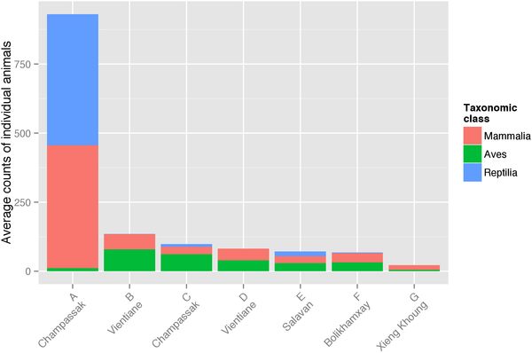
Wildlife Trade Survey
21visited in 7 wildlife hotspot markets
6,609 individual wild animals or an estimated 2,066 kg of biomass were observed for sale.
2,021 individual mammals (30.6%), 3,074 birds (46.5%) and 1,514 reptiles (22.9%).
Of the mammals (21 genera from 12 families) that are capable of hosting 36 significant zoonoses: Rabies, SARS, leptospirosis and Mycobacterium tuberculosis…
Average number of alive or fresh dead animals per day for markets
Notes:
ນອກຈາກການເກັບຕົວຢ່າງຈາກສັດປ່າ ທີ່ຄ້າຂາຍຢູ່ຕາມຕະຫຼາດ ເພື່ອການວິໄຈແລ້ວ
ພວກເຮົາຍັງໄດ້ ເກັບກໍາຂໍ້ມູນການຄ້າຂາຍສັດປ່າໃນຂອບເຂດທົ່ວປະເທດ ເພື່ອເບິ່ງຊະນິດພັນ ແລະ ປະລິມານ ສັດປ່າ ທີ່ຖືກນໍາມາ ຄ້າຂາຍຢູ່ຕະຫຼາດເພື່ອການບໍລິໂພກນໍາ
ຈາກຜົນການວິເຄາະຂໍ້ມູນ ສະເພາະ 7 ຕະຫຼາດທີ່ມີການຄ້າຂາຍສັດປ່າສູງ ໃນການສໍາຫຼວທັງໝົດ 27 ຄັ້ງພົບວ່າ: ມີສັດປ່າຖືກລ່າມາຂາຍເຖິງ 6,609 ແລະ ໃນນັ້ນມີສັດລ້ຽງດ້ວຍນໍ້ານົມຫຼາຍກວ່າ 2,021 ໂຕ ແລະ ຈາກການຈັດຈໍາແນກຊະນິດພົບວ່າ: ມີສັດລ້ຽງດ້ວຍນໍ້ານົມເຖິງ 21 ສະກຸນ ຈາກ 12 ຕະກຸນ ຖືກວາງຂາຍຢູ່ຕະຫຼາດ ທີ່ມີຄວາມເປັນໄປໄດ້ ໃນການຖືເຊື້ອພະຍາດຕິດຕໍ່ຈາກສັດສູ່ຄົນ 36 ສາຍພັນແຕກຕ່າງກັນ: rabies, SARS, leptospirosis and Mycobacterium tuberculosis...

Slide 8
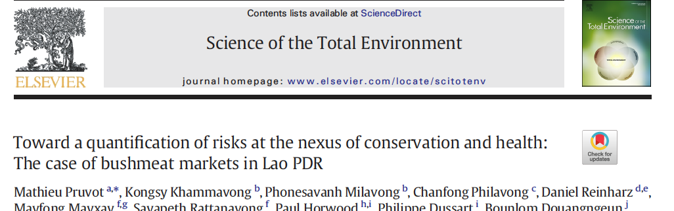
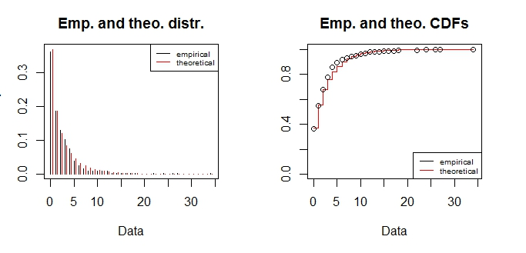
How do wildlife vendor and consumer interact with wildlife?
Distribution of number of contacts per animal per 20min period
Average contact rate per species
Contact rates with wildlife
53h observation
211 animal.hours 7 contacts/animal.hour
1484 contacts
Mean=2.39 contacts/animal/20min
(~7 contact/animal/hour )
Notes:
ນອກນັ້ນ, ພວກເຮົາຍັງໄດ້ເຮັດການຄົ້ວຄວ້າ ເບິ່ງພຶດຕິກໍາຂອງ ຜູ້ທີ່ມາຊື້ ສັດປ່າ ຢູ່ຕາມຕະຫຼາດ
ແລະ ຜົນການວິເຄາະຂໍ້ມູນ ພົບວ່າ ໃນ 1 ຊົ່ວໄມງໃດ ຈະມີຄົນ ຫຼື ຜູ້ ຊື້ ມາສໍາຜັດຈັບບາຍ ສັດ ເຖິງ 7 ຄົນ/ສັດ 1 ໂຕ
ເຮົາກັບໄປເບິ່ງຄືນ ຂໍ້ມູນຜົນການສໍາຫຼວດການຄ້າຂາຍສັດ ໃນຊ່ວງໄລຍະຂອງ PREDICT ທີ່ພົບສັດລ້ຽງລູກ ດ້ວຍນໍ້ານົມ ທີ່ຖືນນໍາມາຄ້າຂາຍ ເຖິງ 2000 ໂຕ
ແລ້ວເຮົາກັບມາຄິດເບິ່ງວ່າ ສຸຂະພາບຂອງຄົນເຮົາ ມີຄວາມສ່ຽງຫຼາຍໜ້ອຍພຽງໃດ ຈາກພະຍາດຕິດຕໍ່ຈາກສັດປ່າ

Slide 9
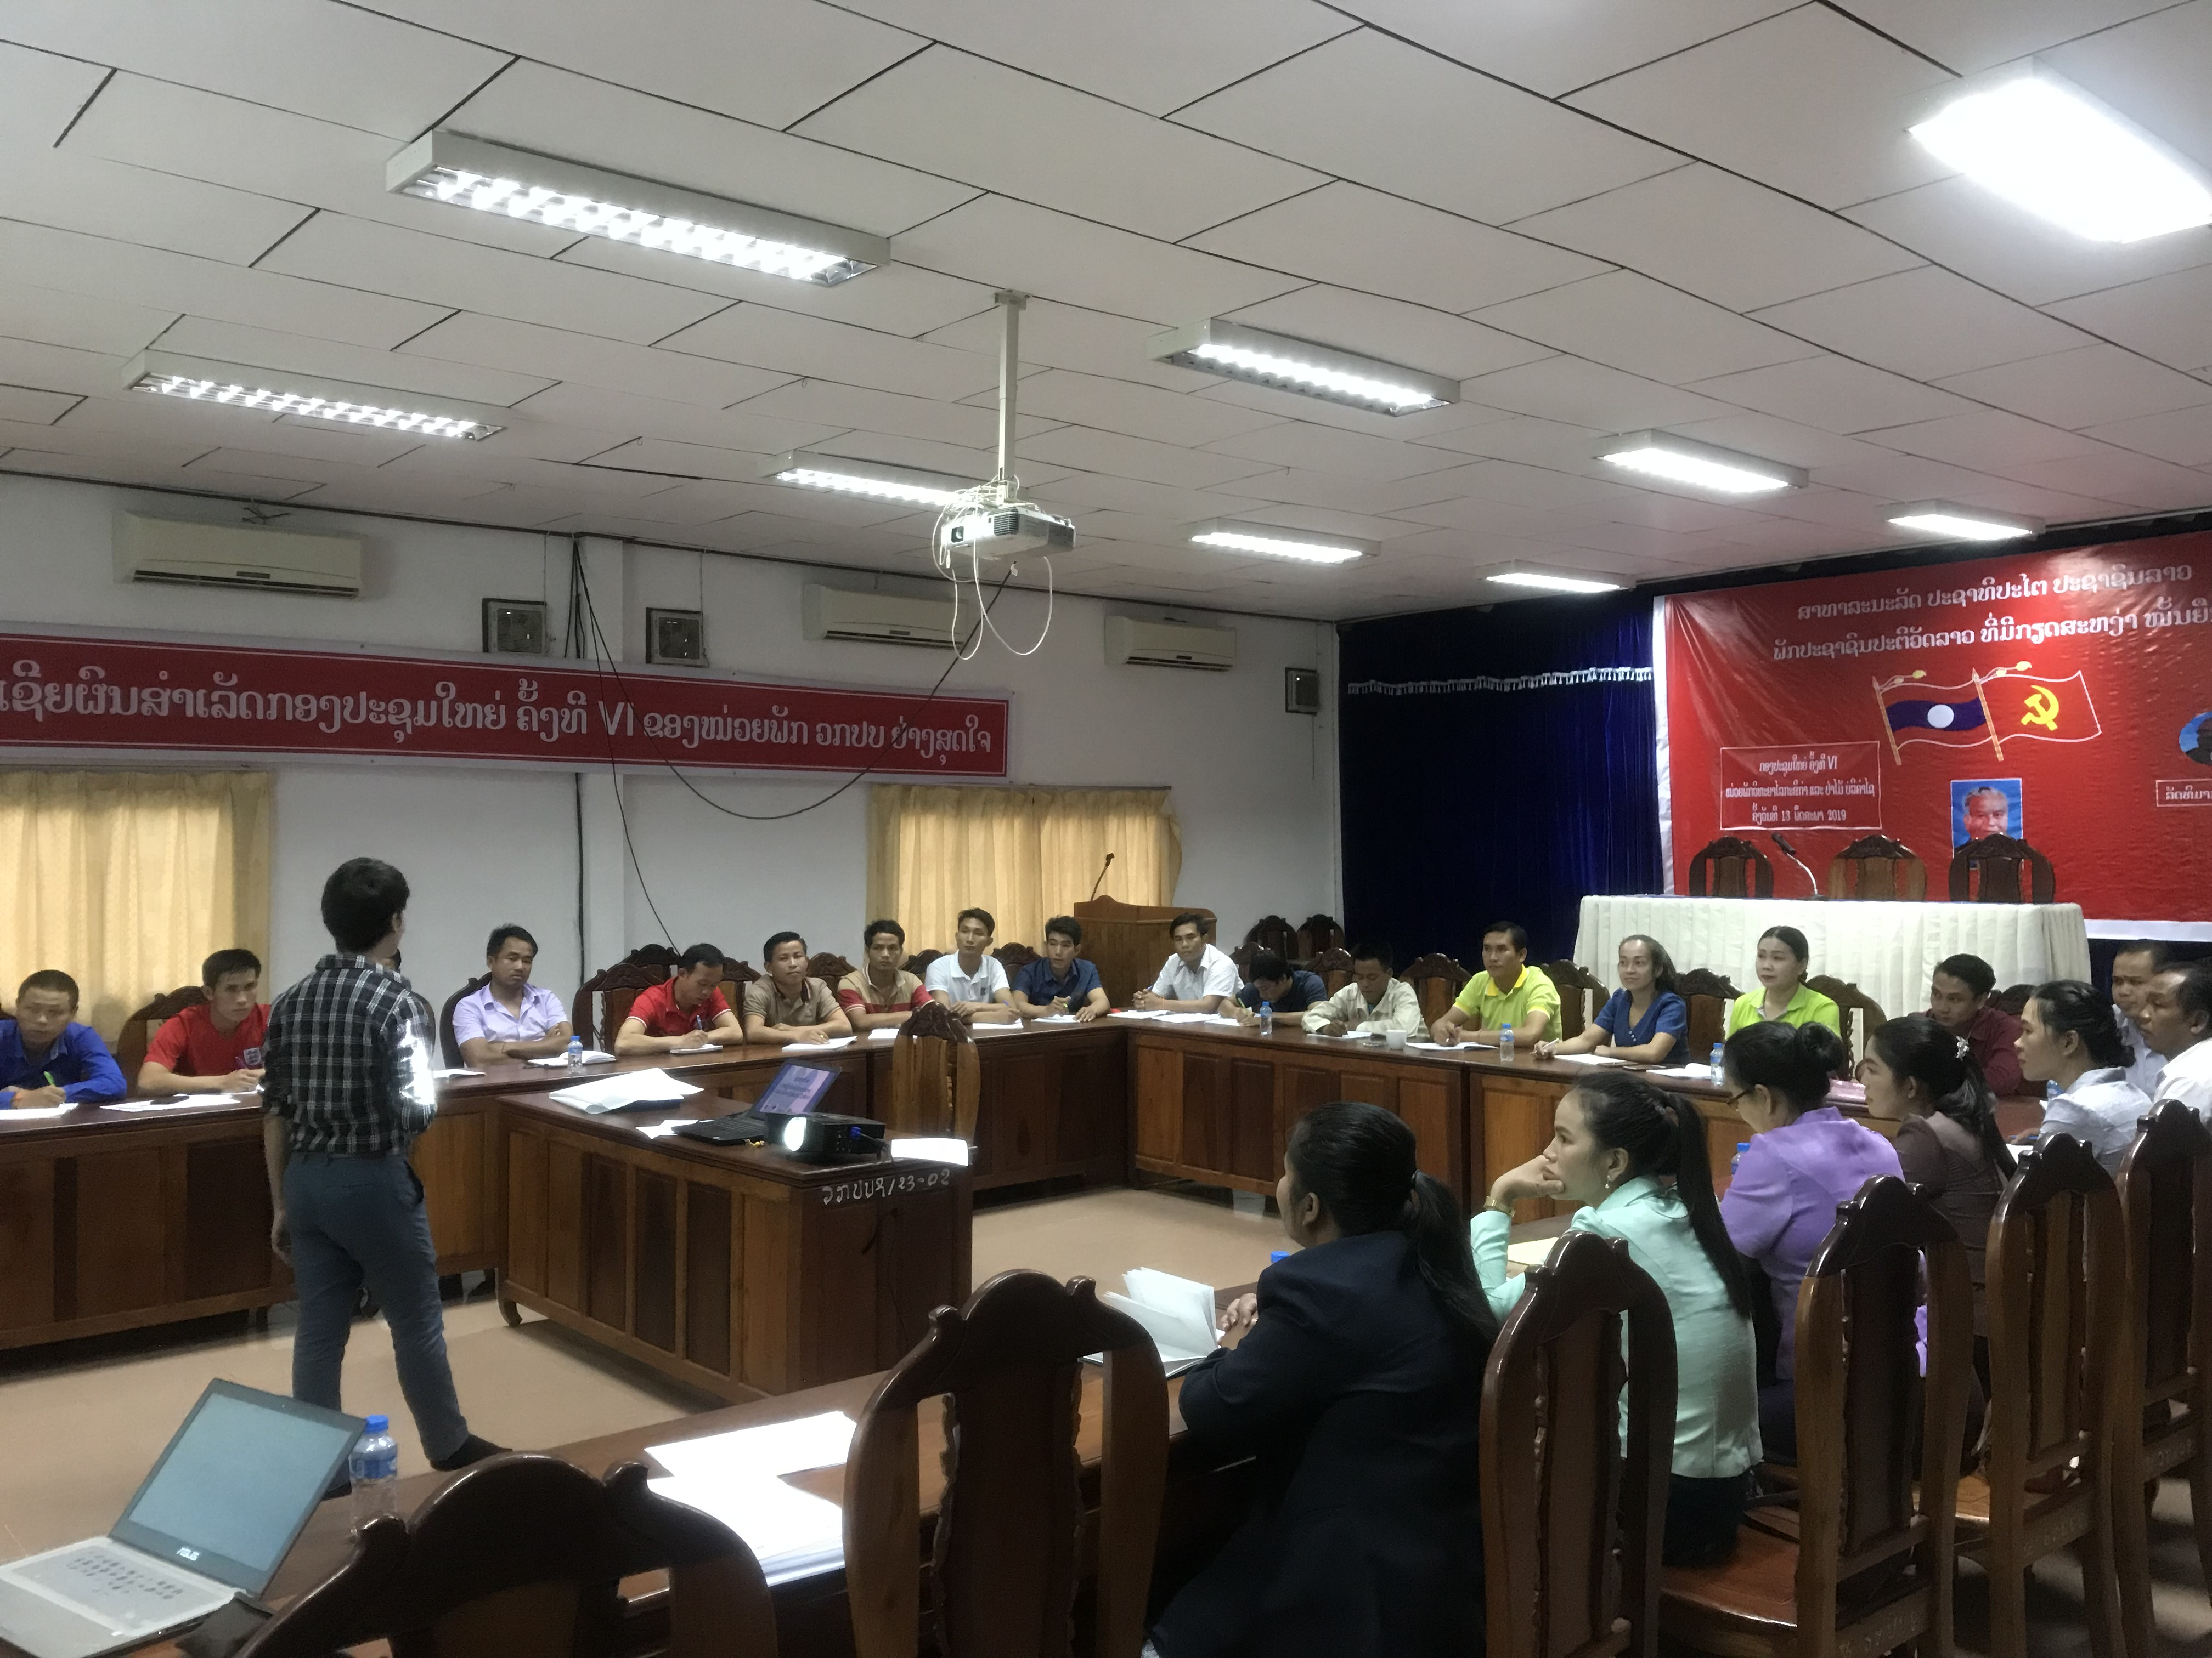
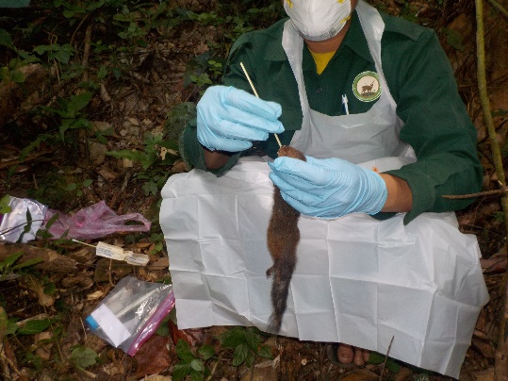
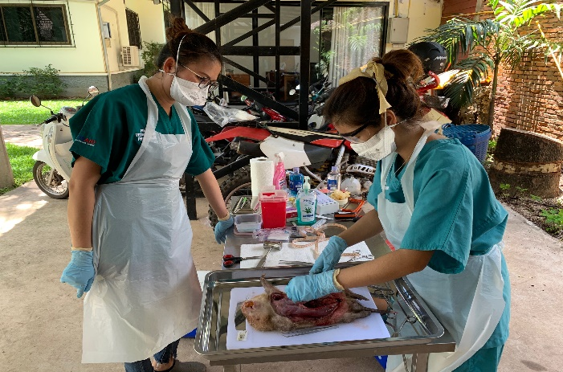
WCS Health Program in Lao PDR
Build the technical capacity of government and local stakeholders:
Trainees from 2 landscapes: forest rangers, biodiversity monitoring, forest inspections, livestock officers,
Capacity in:
Inform on risk and prevention (PPE)
Report of wildlife mortality/morbidity
Collect samples or carcasses and perform necropsy
Laboratory capacity building

Slide 10
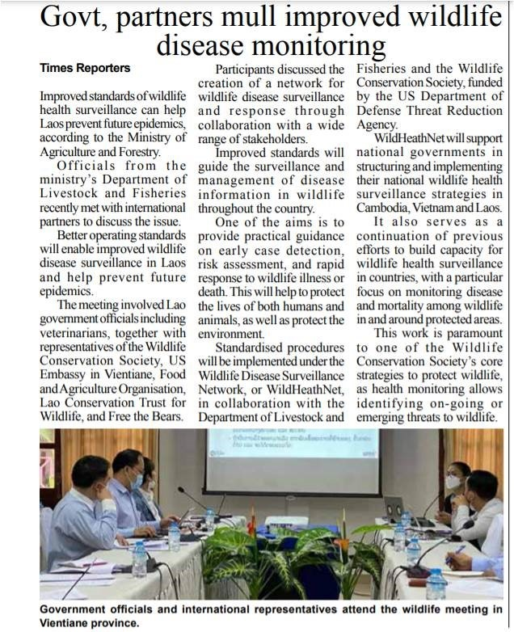
Influence and contributed into developing of national policy
SOP for wildlife health surveillance in Lao PDR
Notes:
a Standard Operating Procedure (SOP) for Wildlife Health Surveillance has been developed and successfully adopted into national policy — the first of its kind in the country. Veterinary experts, forestry and protected area management, wildlife rescue centers, laboratory staff, law enforcement, and public health professionals all had an active voice in its co-construction

Slide 11
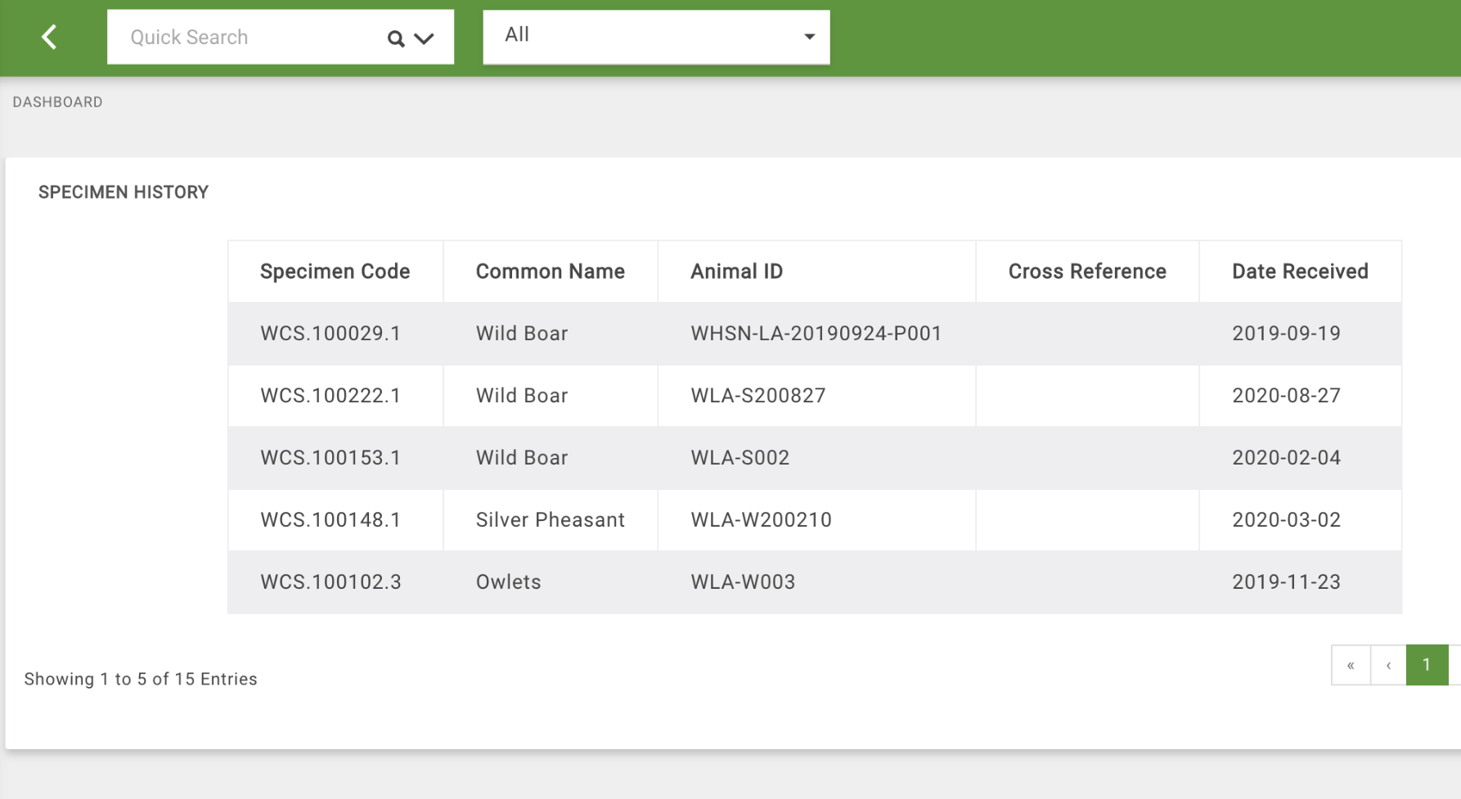
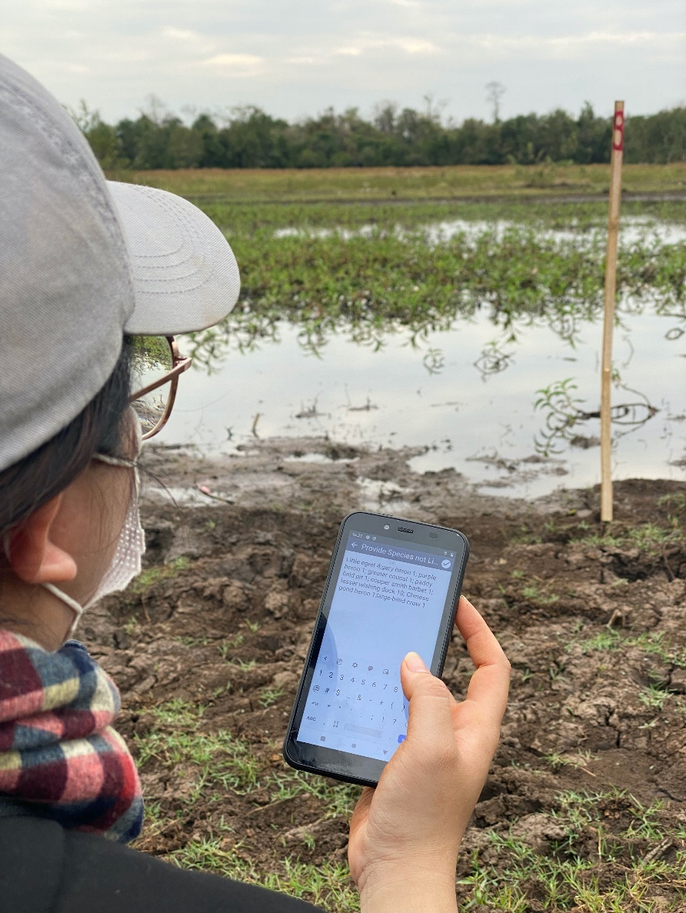
Standardizing data collection (SMART for Health) and management (WHIP)
WHIP

Slide 12
Under looking for funding opportunities to:
Implement and disseminate of the national Standard Operating Procedure (SOP) for Wildlife Health Surveillance
Pilot the roll-out of the SOP in target Protected Areas
Pilot the roll-out of the SOP within the Department of Forest Inspection and other law enforcement agencies to support monitoring wildlife health along the supply chain in Lao PDR
Expand wildlife disease surveillance to the national scale

Slide 13
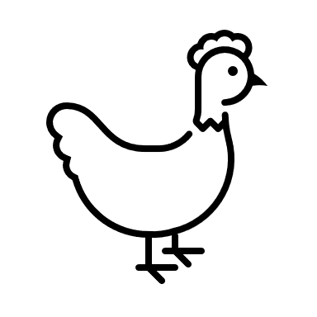
Thank You

